Slide 1

Security Assessment and Risk Management
Week 5 – Strategy

Slide 2
Prisoner’s dilemma
Two criminals have been arrested and the police visit them separately
If one player testifies against the other and the other refuses, the one who testified goes free and the one who refused gets a 10-year sentence
If both players testify against each other, they each get a 5-year sentence
If both refuse to testify, they each get a 1-year sentence
 | Alice: Testify | Alice: Refuse
Bob: Testify | -5 -5 | 0 -10
Bob: Refuse | -10 0 | -1 -1

Slide 3
Prisoner’s dilemma
This is a…
Simultaneous
One-Off
Non-Zero Sum
Game

Slide 4
Prisoner’s dilemma
Alice’s reasoning:
Suppose Bob testifies. Then I get 5 years if I testify and 10 years if I refuse. So I should testify.
Suppose Bob refuses. Then I go free if I testify, and get 1 year if I refuse. So I should testify.
Nash equilibrium: A pair of strategies such that no player can get a bigger payoff by switching strategies, provided the other player sticks with the same strategy
(Testify, Testify) is a Nash equilibrium
 | Alice: Testify | Alice: Refuse
Bob: Testify | -5 -5 | 0 -10
Bob: Refuse | -10 0 | -1 -1

Slide 5
Prisoner’s dilemma
Dominant strategy: A strategy whose outcome is better for the player regardless of the strategy chosen by the other player.
TESTIFY!
Pareto optimal outcome: It is impossible to make one of the players better off without making another one worse off.
(Testify, Refuse)
(Refuse, Refuse)
(Refuse, Testify)
Other games can be constructed in which there is no dominant strategy – we’ll see some later
 | Alice: Testify | Alice: Refuse
Bob: Testify | -5 -5 | 0 -10
Bob: Refuse | -10 0 | -1 -1

Slide 6
 | Defect | Cooperate
Defect | Lose – lose | Lose big – win big
Cooperate | Win big – lose big | Win – win
Price war
Arms race
Diner’s dilemma
Collective action in politics
One-Time Fund Budgeting

Slide 7
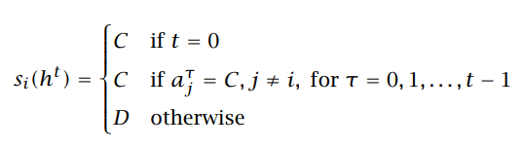
Game Strategies
• Always Defect (ALL-D). This strategy prescribes defecting after every history no matter what the other player has done. So, si(ht) = D for all t = 0, 1,....
• Always Cooperate (ALL-C). This strategy prescribes cooperating after every history no matter what the other player has done. So, si(ht) = C for all t = 0, 1,....
• Naïve Grim Trigger (N-GRIM). This strategy prescribes cooperating while the other player cooperates and, should the other player defect even once, defect forever thereafter:

Slide 8
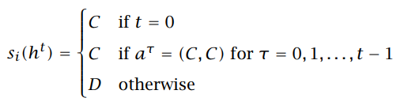
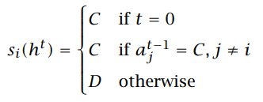
Game Strategies
• Grim Trigger (GRIM). This strategy prescribes cooperating in the initial period and then cooperating as long as both players cooperated in all previous periods:
• Tit-for-Tat (TFT). This strategy prescribes cooperation in the first period and then playing whatever the other player did in the previous period: defect if the other player defected, and cooperate if the other player cooperated:

Slide 9
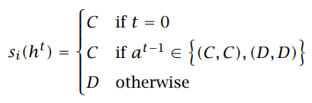
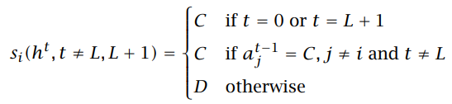
Game Strategies
• Pavlov (WS-LS). Also called, win-stay, lose-shift, this strategy prescribes cooperation in the first period and then cooperation after any history in which the last outcome was either (C, C) or (D, D) and defection otherwise:
• Deviate Once (DEV1L). This strategy prescribes TFT until period L, then deviating in period L, cooperating in period L + 1, and playing TFT thereafter.

Slide 10
Is there any way to get a better answer?
Superrationality
Assume that the answer to a symmetric problem will be the same for both players
Maximize the payoff to each player while considering only identical strategies
Not a conventional model in game theory
… same thing as the Categorical Imperative?
Repeated games
If the number of rounds is fixed and known in advance, the equilibrium strategy is still to defect (limited-horizon game)
If the number of rounds is unknown, cooperation may become an equilibrium strategy (infinite-horizon game)

Slide 11

Game of Chicken
Outcomes:
If one player chickens out, the other wins $1000
If both players chicken out, neither wins anything
If neither player chickens out, they both lose $10,000 (the cost of the car)
Anti-coordination game: it is mutually beneficial for the two players to choose different strategies
Chicken
 | S | C
S | -10, -10 | -1, 1
C | 1, -1 | 0, 0
Straight
Chicken
Straight

Slide 12
Prisoner’s dilemma vs. Chicken
Prisoner’ dilemma
Chicken
 | Cooperate | Defect
Cooperate | Win – win | Win big – Lose big
Defect | Lose big – Win big | Lose – Lose
 | Chicken | Straight
Chicken | Nil – Nil | Win – Lose
Straight | Lose – Win | Lose big – Lose big
Players can’t improve their winnings by unilaterally cooperating
The best strategy is always the opposite of what the other player does

Slide 13
Mixed strategy equilibria
Mixed strategy: a player chooses between the moves according to a probability distribution
Suppose each player chooses S with probability 1/10. Is that a Nash equilibrium?
Consider payoffs to P1 while keeping P2’s strategy fixed
The payoff of P1 choosing S is (1/10)(–10) + (9/10)1 = –1/10
The payoff of P1 choosing C is (1/10)(–1) + (9/10)0 = –1/10
Can P1 change their strategy to get a better payoff?
Same reasoning applies to P2

Slide 14
Finding mixed strategy equilibria
Expected payoffs for P1 given P2’s strategy:
P1 chooses S: q(–10) +(1–q)1 = –11q + 1
P1 chooses C: q(–1) + (1–q)0 = –q
In order for P2’s strategy to be part of a Nash equilibrium, P1 has to be indifferent between its two actions:
–11q + 1 = –q or q = 1/10
Similarly, p = 1/10
 | P1: Choose S with prob. p | P1: Choose C with prob. 1-p
P2: Choose S with prob. q | -10, -10 | -1, 1
P2: Choose C with prob. 1-q | 1, -1 | 0, 0

Slide 15
Existence of Nash equilibria
Any game with a finite set of actions has at least one Nash equilibrium (which may be a mixed-strategy equilibrium)
If a player has a dominant strategy, there exists a Nash equilibrium in which the player plays that strategy and the other player plays the best response to that strategy
If both players have strictly dominant strategies, there exists a Nash equilibrium in which they play those strategies

Slide 16
The Stag Hunt
This is a…
Sequential
Infinite-Horizon
Non-Zero Sum
Game.

Slide 17
The Stag Hunt
The Stag Hunt game is based on a story told by Jean Jacques Rousseau in his book Discourses on the Origin and Foundation of Inequality Among Men (1754).
Two hunters set out to kill a stag. One has agreed to drive the stag through the forest, and the other to post at a place where the stag must pass. If both faithfully perform their assigned stag-hunting tasks, they will surely kill the stag and each will get an equal share of this large animal.
During the course of the hunt, each hunter has an opportunity to abandon the stag hunt and to pursue a hare. If a hunter pursues the hare instead of the stag he is certain to catch the hare and the stag is certain to escape. Each hunter would rather share half of a stag than have a hare to himself.”

Slide 18
Cooperation / Coordination Games
The matrix below shows payoffs in a stag hunt game. If both hunters hunt stag, each gets a payoff of 4. If both hunt hare, each gets 3. If one hunts stag and the other hunts hare, the stag hunter gets 0 and the hare hunter gets 3.
If you are sure that the other hunter will hunt stag, what is the best thing for you to do?
If you are sure that the other hunter will hunt hare, what is the best thing for you to do?
Does either hunter have a dominant strategy in this game? No. If so, what is it? If not explain why not.
This game has two pure strategy Nash equilibria. What are they?
 |  | Hunter B
 |  | Hunt Stag | Hunt Hare
Hunter A | Hunt Stag | 4, 4 | 0, 3
 | Hunt Hare | 3, 0 | 3, 3
Notes:
If you are sure that the other hunter will hunt stag, what is the best thing for you to do? Hunt Stag
If you are sure that the other hunter will hunt hare, what is the best thing for you to do? Hunt Hare
Does either hunter have a dominant strategy in this game? No. If so, what is it? If not explain why not. No, the best response depends on other player
This game has two pure strategy Nash equilibria. What are they? Both Hare or Both Stag

Slide 19
Cooperation / Coordination Games
Coordination game: it is mutually beneficial for the two players to choose the same strategies
Is one Nash equilibrium better for both hunters than the other? Yes If so, which is the better equilibrium?
If a hunter believes that with probability ½ the other hunter will hunt stag and with probability ½ he will hunt hare, what should this hunter do to maximize his expected payoff?
Can you think of any real life economic or political situations that can be modelled as a Stag Hunt Game? Give an example.
 |  | Hunter B
 |  | Hunt Stag | Hunt Hare
Hunter A | Hunt Stag | 4, 4 | 0, 3
 | Hunt Hare | 3, 0 | 3, 3
Notes:
Is one Nash equilibrium better for both hunters than the other? Yes If so, which is the better equilibrium? Yes, both hunt stag
If a hunter believes that with probability ½ the other hunter will hunt stag and with probability ½ he will hunt hare, what should this hunter do to maximize his expected payoff? Then 𝑬[𝑺𝒕𝒂𝒈]=𝟒 𝟏/𝟐+𝟎 𝟏/𝟐=𝟐 and 𝑬[𝑯𝒂𝒓𝒆]=𝟑 𝟏/𝟐+𝟑 𝟏/𝟐=𝟑 → Hare.
Can you think of any real life economic or political situations that can be modelled as a Stag Hunt Game? Give an example. Pirates Mutiny, MPs not wanting to be in a minority vote, Hockey Players

Slide 20
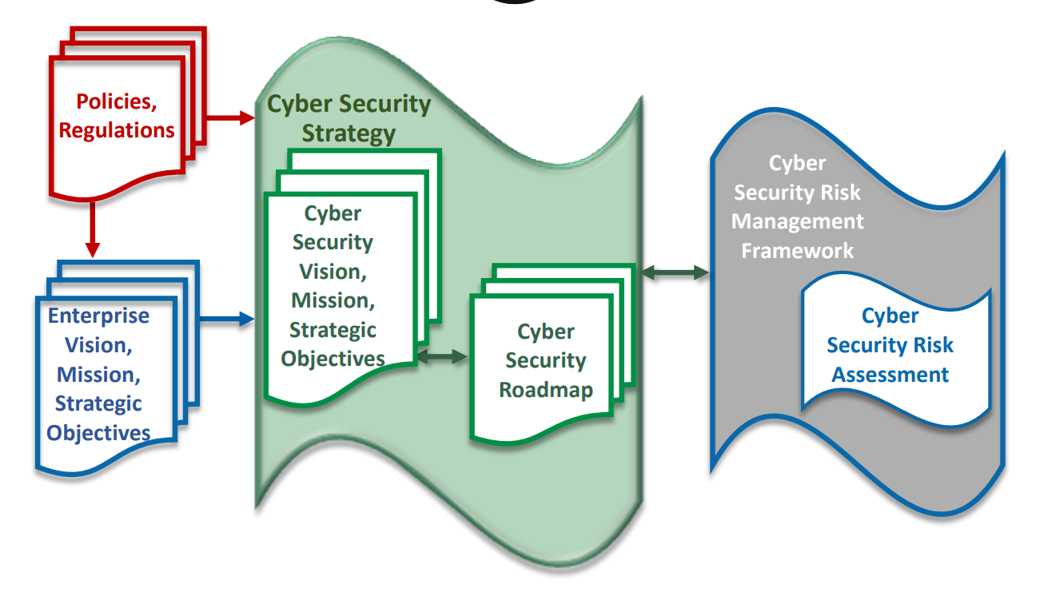

Slide 21
Constraints
Funding
Regulations and Laws
Staff Time and Talent
Business Overhead
Political Capital
Accountability
Calendar Time

Slide 22
Governance
Light: University Leadership, Executive Board
For Authority
Moderate: Advisory Council, Committees
For Feedback
Heavy: Governance Board, Faculty Senate
For Approval

Slide 23
Cyberstrategy Patterns
People-Centric
Information-Centric
Kill Chain
Defense in Depth
Security Zones
Business Aligned
ISO 27000
NIST CSF
Technology-Centric
Vendor-Centric
Network-Centric
Edge-to-Edge
Process Maturity Model
Software Defined
Perimeter Security

Slide 24
People-Centric
Some problems and solutions are rooted in people. People and data tend to be the most valuable assets in an organization. People represent position, knowledge.
Most attacked users
Most sensitive users
Least adaptable user
Etc.

Slide 25
Information-Centric
Common processes in a data-centric security model include:
Discover: the ability to know what data is stored where including sensitive information.
Manage: the ability to define access policies that will determine if certain data is accessible, editable, or blocked from specific users, or locations.
Protect: the ability to defend against data loss or unauthorized use of data and prevent sensitive data from being sent to unauthorized users or locations.
Monitor: the constant monitoring of data usage to identify meaningful deviations from normal behavior that would point to possible malicious intent.

Slide 26
Information-Centric
From a technical point of view, information (data)-centric security relies on the implementation of the following:
Information (data) that is self-describing and defending.
Policies and controls that account for business context.
Information that remains protected as it moves in and out of applications and storage systems and changing business context.
Policies that work consistently through the different data management technologies and defensive layers implemented.

Slide 27
Strategy Considerations
Authoritative Source of Data: Recognizing the correct source of data.
Layered Security: Configuring multiple security checkpoints.
3rd Party Communication: Understanding the risks of third party relationships.
The Security Provider: Leveraging the power of a common security service.
White Hats, Hack Thyself: Testing your own security by trying to defeat it.
Fail Securely: Designing systems to fail in a secure manner.
Low Hanging Fruit: Taking care of the quick wins.

Slide 28
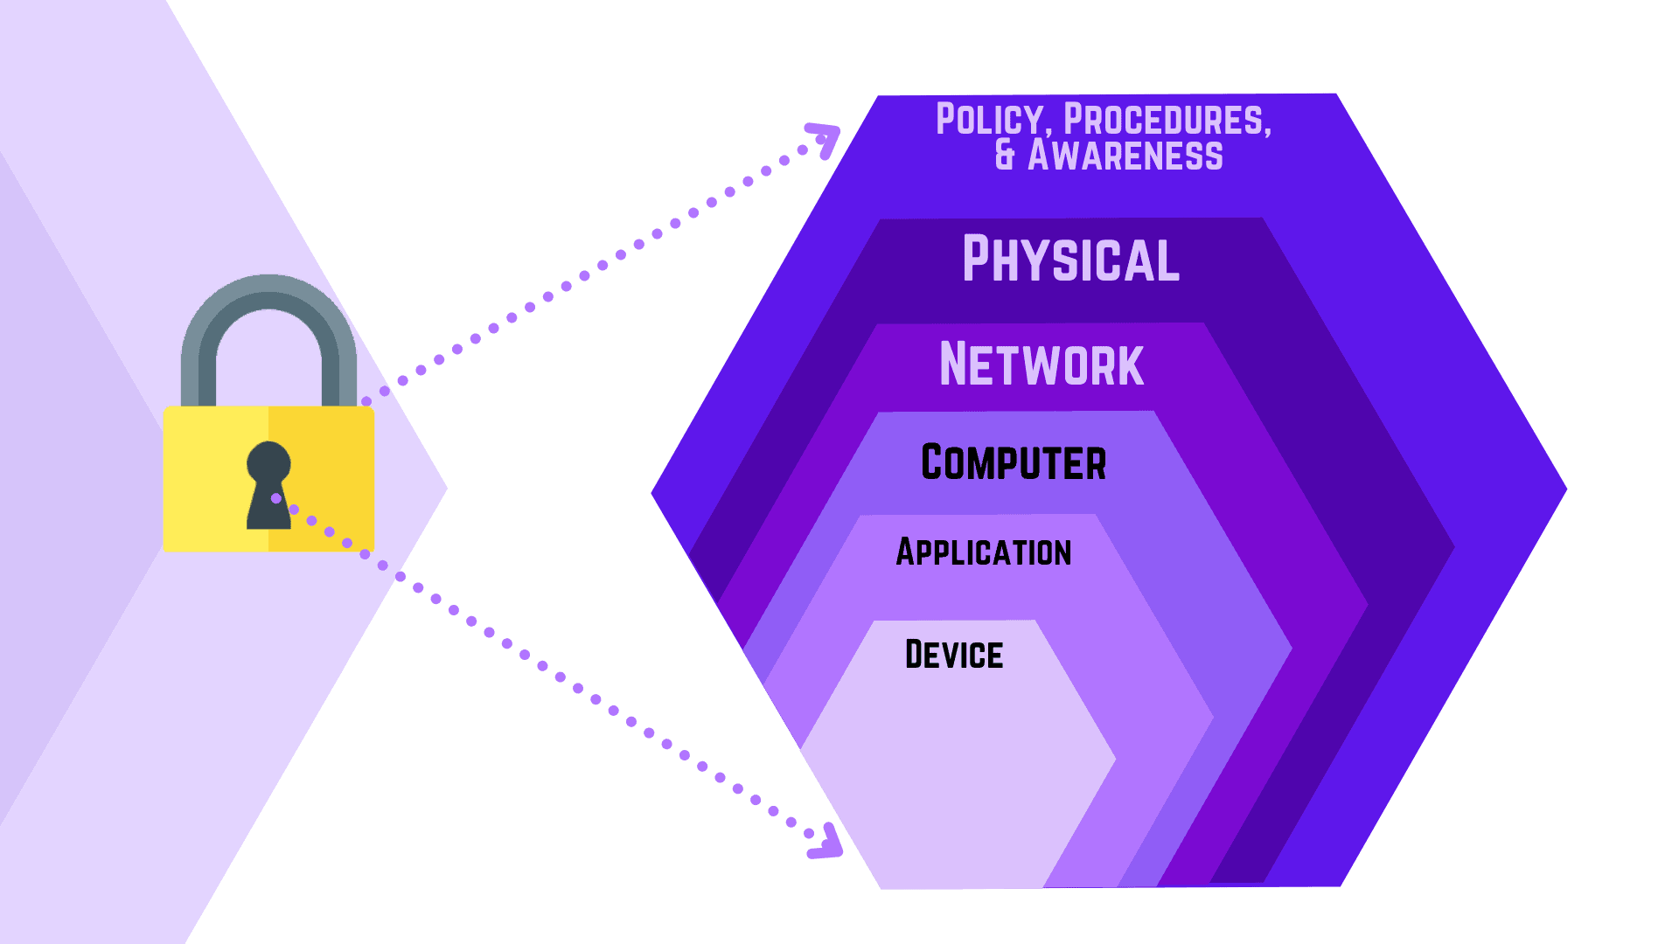
Defense in Depth

Slide 29
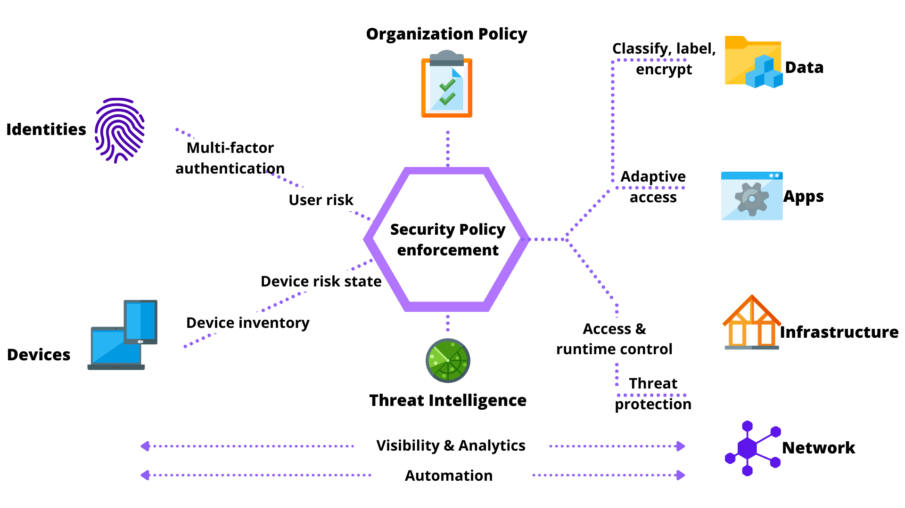

Slide 30
Pitfalls
Technology Sprawl And Lack Of Documentation
Over time, new servers and applications are provisioned to accommodate a business requirement or development testing.
These systems may remain unpatched or can become sources of backdoors.
Legacy Systems
Legacy system that cannot be patched or no longer supported is a high risk.
Insufficient Resources
When it comes to cyber security, time and the utilization of resources is what companies struggle with the most.

